Slide 1
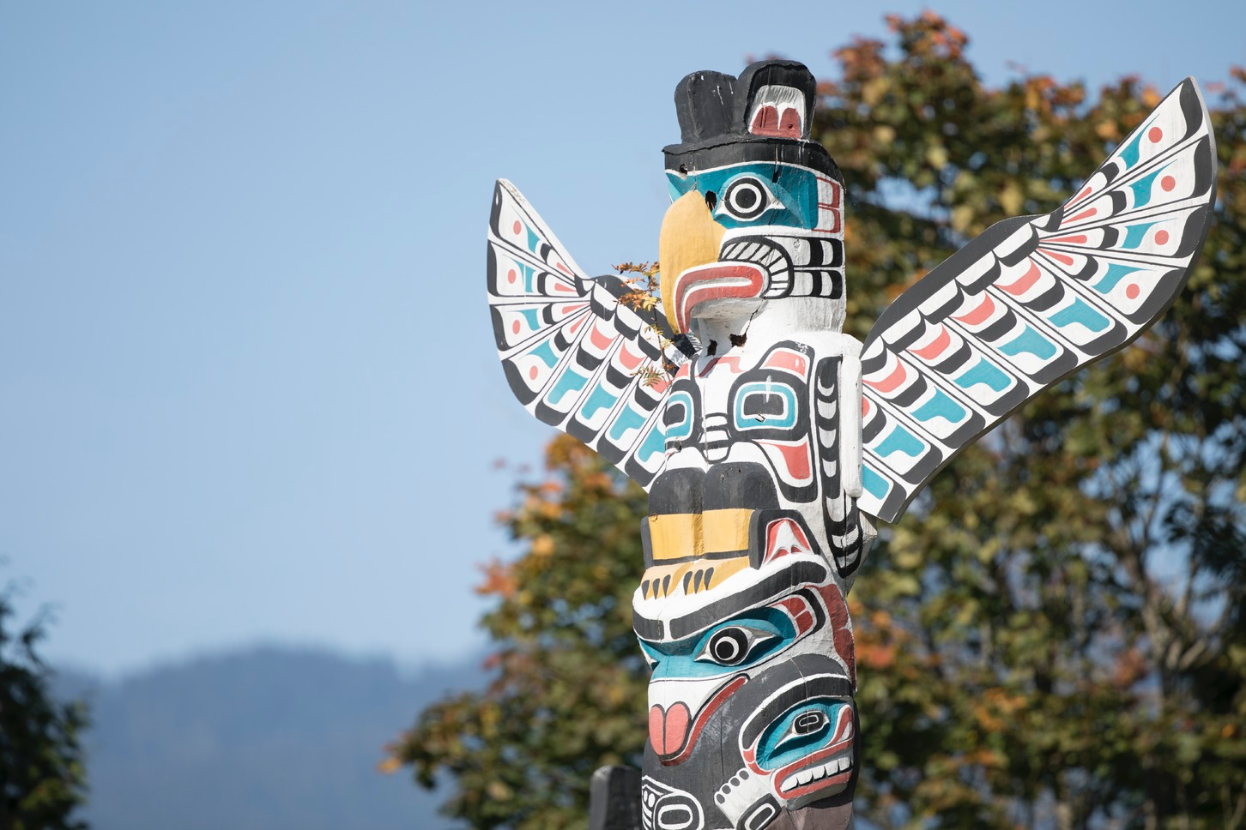
GPS and Accel data…
Presenting Author: Daniel Fuller

Slide 2
Territorial Acknowledgement
We respectfully acknowledge the territory in which we gather as the ancestral homelands of the Beothuk, and the island of Newfoundland as the ancestral homelands of the Mi’kmaq and Beothuk. We would also like to recognize the Inuit of Nunatsiavut and NunatuKavut and the Innu of Nitassinan, and their ancestors, as the original people of Labrador. We strive for respectful relationships with all the peoples of this province as we search for collective healing and true reconciliation and honour this beautiful land together.

Slide 3
COI : No
The 8th International Society for Physical Activity and Health Congress Disclosure of Conflict of Interest Name of first author： Daniel Fuller Affiliation： Memorial University of Newfoundland
I have no Conflict of Interest
with regard to our presentation.

Slide 4
Overview
Promise and challenges of GPS and accelerometer data
20 Minutes
Coding and examples (Using R)
40 minutes
Machine learning – The future?
20 minutes

Slide 5
Background questions
Rate your familiarity with processing GPS data (post in the chat)
0 = No idea ; 10 = Expert
Rate your familiarity with processing accel data (post in the chat)
0 = No idea ; 10 = Expert
Rate your familiarity with processing gps+accel data (post in the chat)
0 = No idea ; 10 = Expert

Slide 6
Promise and challenges
Many conceptual papers about GPS and accel data
James P, Jankowska M, Marx C, et al. “Spatial Energetics.” Am J Prev Med. 2016;51(5):792-800. doi:10.1016/j.amepre.2016.06.006
Duncan MJ, Badland HM, Mummery WK. Applying GPS to enhance understanding of transport-related physical activity. J Sci Med Sport. 2009;12(5):549-556. doi:10.1016/j.jsams.2008.10.010
Attempts to simplify and automate the processes
PALMS
HABITUS (https://www.habitus.eu/)

Slide 7
Promise and challenges
Fewer consistent and well developed papers combining and applying GPS and accel data
No standard methods: Everything is bespoke decisions, assumptions, and code
Need to work to standardize or make more explicit our goals

Slide 8
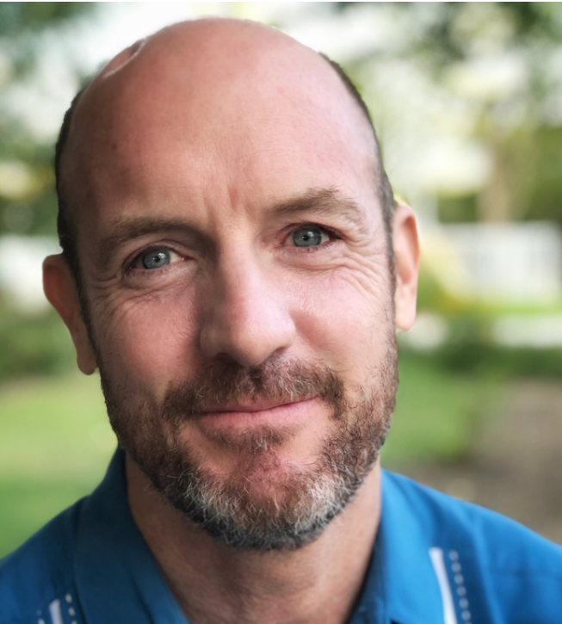
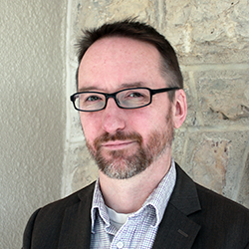


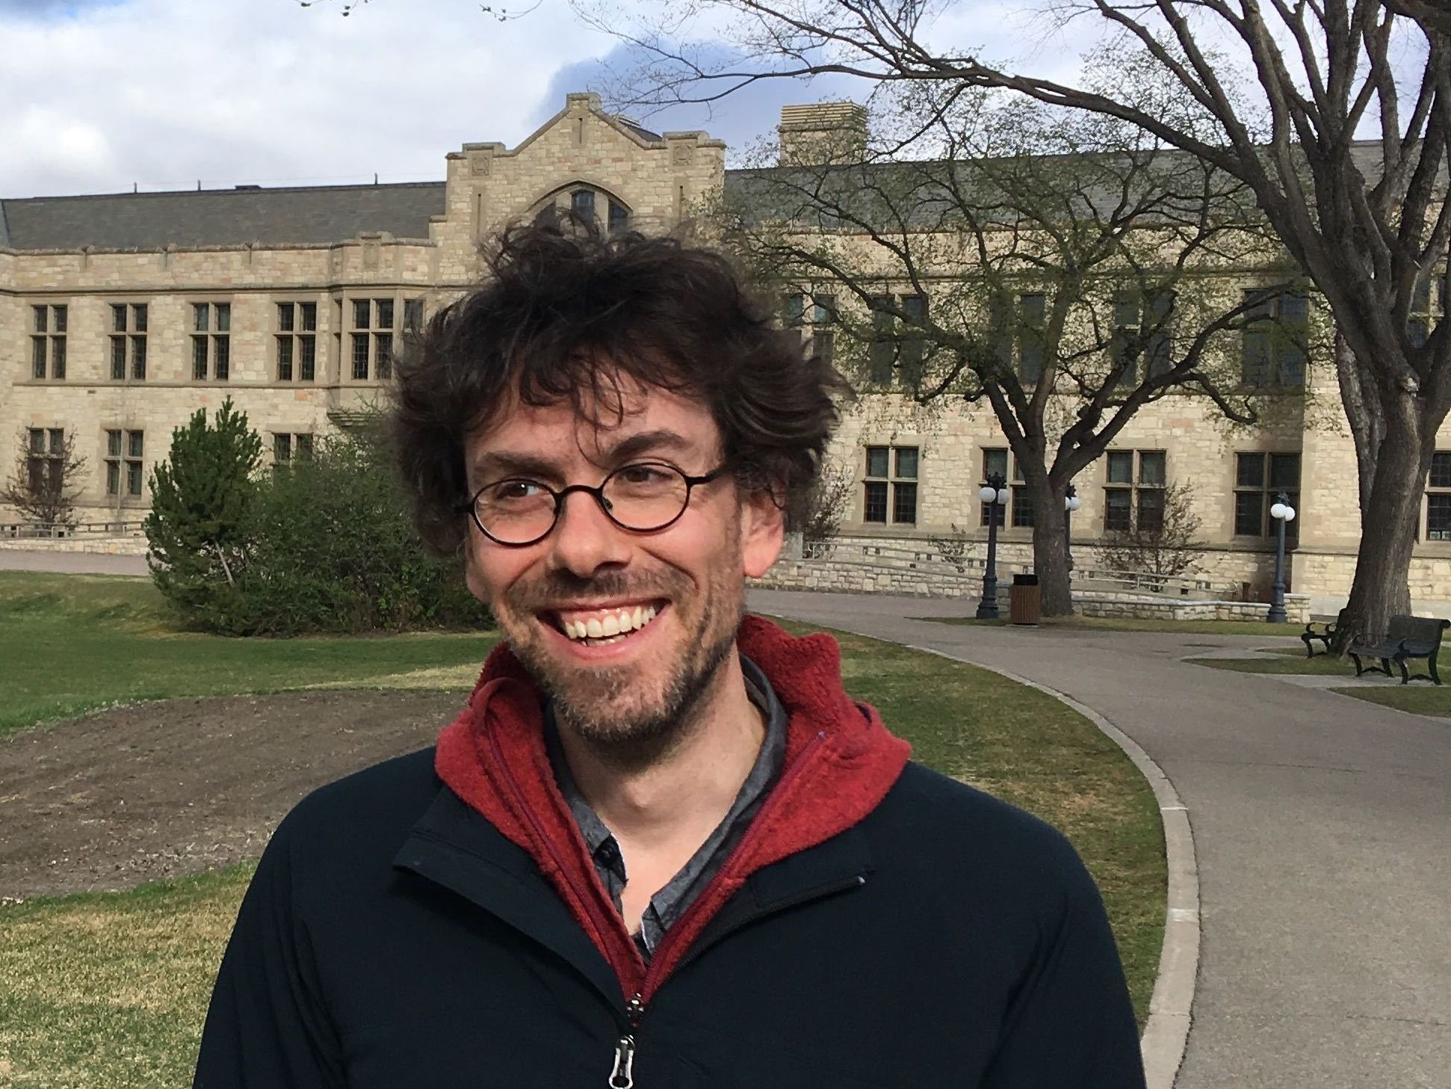
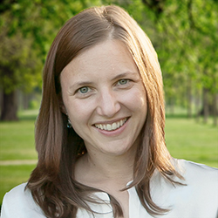
Our team
INTERACT is a pan-Canadian collaboration of scientists, urban planners, and citizens uncovering the impact of urban changes on health and equity.
4 cities, 2500 participants
Over 8TB of GPS and Accel data
Dedicated GPS and Accel + Smartphone app

Slide 9
Accel data
Measures acceleration in X,Y,Z axis
Hip, wrist, or other locations
Used to calculate activity intensity, activity type, or both
Intensity (Sedentary, Light, Moderate, Vigorous)
Type (Siting, Standing, Walking, Running)
Intensity and Type (Siting, Walking 3METS, Walking 7METS)
Many, many, many approaches… probably too many

Slide 10
Accel data
Processing
Raw Accelerometer processing
Filter and/or smooth the high frequency accelerometer signal (10-100Hz)
Combine the filtered x,y,z data in some way
Summarize the combined filtered x,y,z data
ActiGraph Activity Counts (AAC)
Euclidean Norm Minus One (ENMO)
Monitor Independent Movement Summary (MIMS)

Slide 11
Accel data
Wearing
Device wear detection
Choi algorithm is the standard
Classification
Classify activity into groups based on combined x,y,z data
Rule based classification
Cut-points
Machine learning based classification
More on that later

Slide 12
Accel data
End result
Minute by minute classification for activity intensity, type, or both depending on the method you use
Can sum up to to get minutes of MVPA or sedentary minutes per day, week, etc.
Can also sum up by spatial concepts like activity space, trips along bike lanes, or home location.

Slide 13
GPS data
Collects spatial location data based on trilateration of location from Global Positioning System Satellites (https://en.wikipedia.org/wiki/Satellite_navigation)
GPS (USA)
GLONASS (Russia)
BeiDU (China)
Location can also come from cell phone towers through cell phone.
Sensor fusion can create one location that combines GPS and cell phone location to get a more accurate location estimate

Slide 14
GPS data
GPS Strengths and Limitations
Strengths
Global
Accurate (a best +/- 5 meters)
Very common
Limitations
Not good inside
Urban canyons
Slow to connect when signal is lost

Slide 15
Why combine data?
Better measures of exposures that are spatially distributed
Can create new metrics
Trips and dwells
Transportation mode detection

Slide 16
Questions?

Slide 17
Jump to R
Caveats
There are no right answers
This is not a definitive guide
Lots of hard thinking needs to happen
Stop me and ask questions

Slide 18
Back from R
Time is terrible
You will drop a lot of data (typically accel data)

Slide 19
Machine learning and fancy stuff
Activity spaces
Convex hull
Standard deviation ellipse
Buffer area
Entropy
Fractal Dimension
First 3 can easily be calculated for the GPS data.
https://geocompr.robinlovelace.net/ will get you started

Slide 20
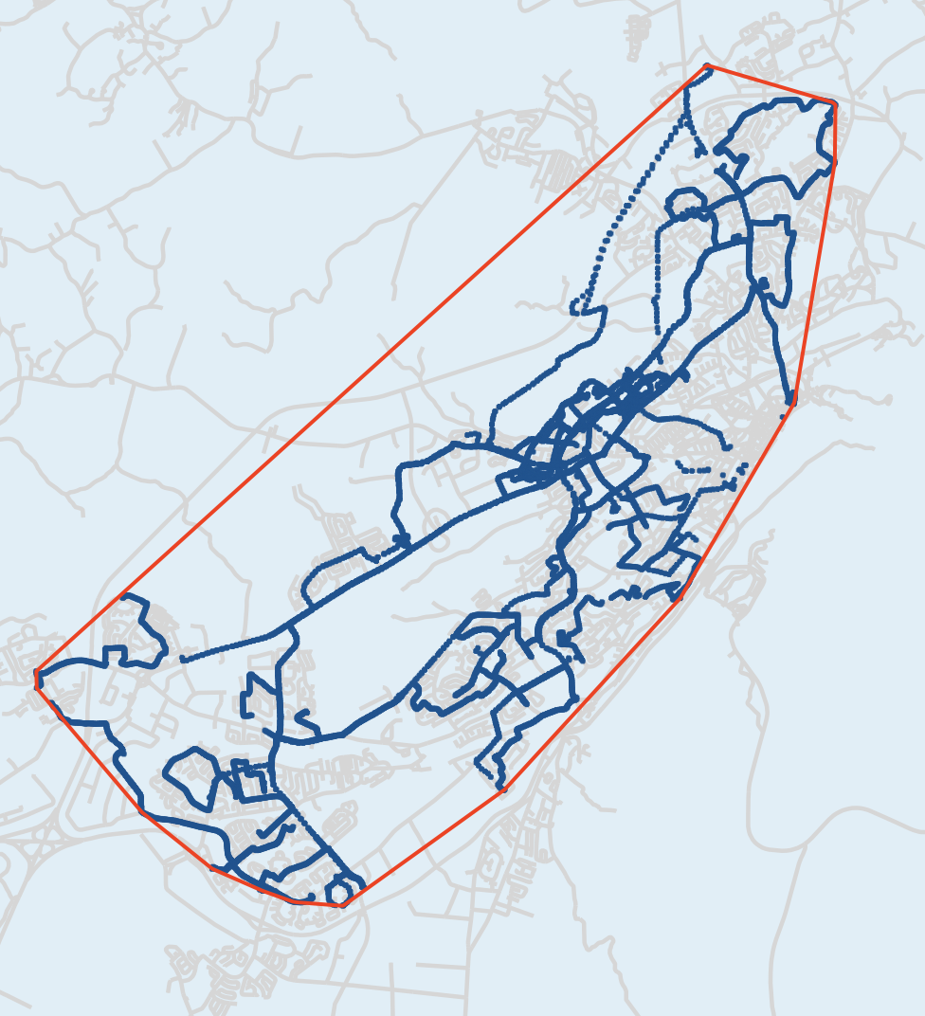
Convex Hull

Slide 21
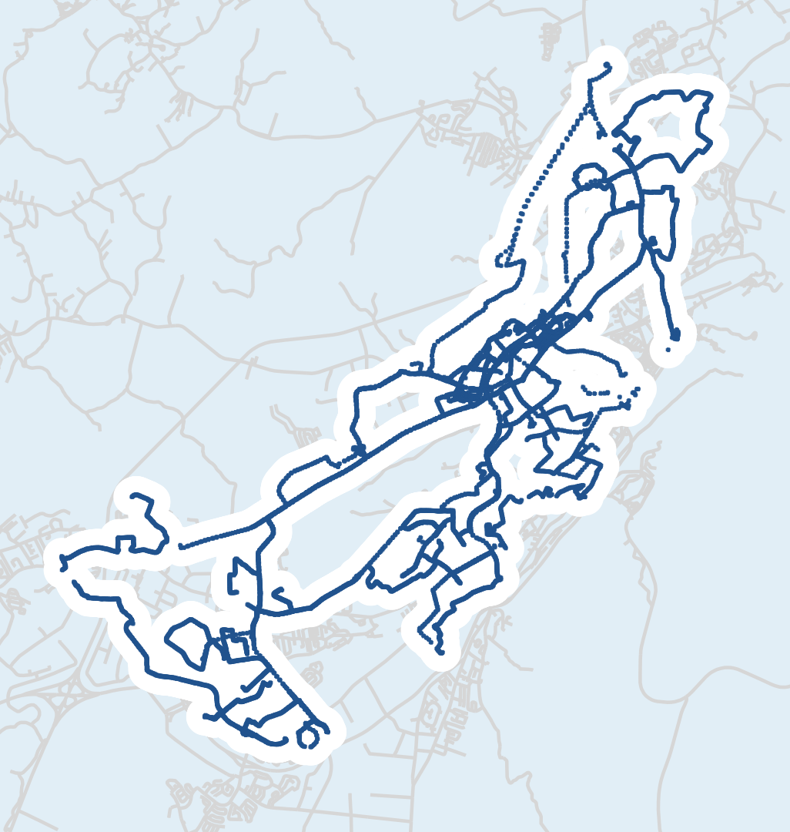
Buffer Area

Slide 22

Entropy
Entropy is a scientific concept, as well as a measurable physical property that is most commonly associated with a state of disorder, randomness, or uncertainty.
Paul, et al. 2018. Multiscale entropy rate analysis of complex mobile agents. Royal Society open science 5, 10 (2018), 180488.

Slide 23
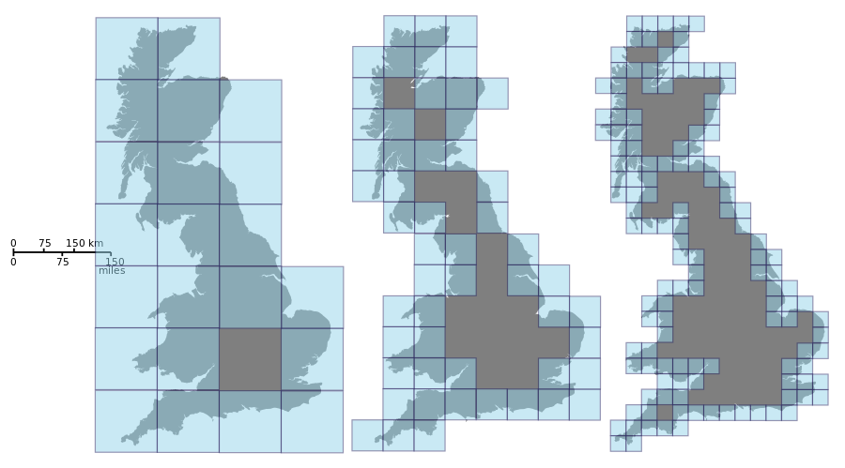
Fractal Dimension
Fractal Dimension is a statistical index of complexity comparing how detail in a pattern changes with the scale at which it is measured.
Zhang R, Stanley K, Fuller D, Bell S. Differentiating Population Spatial Behavior using Representative Features of Geospatial Mobility (ReFGeM). Transactions on Spatial Algorithms and Systems. 2020:6(1). https://dl.acm.org/doi/10.1145/3362063

Slide 24
Machine learning and fancy stuff
Trip and dwell detection
Thierry et al. 2013
Broach 2019
Feasible to do with most if not all GPS data. Tools exist to help with this. Gets you cleaner data that you can them calculate for example how active in terms of minutes of MVPA each trips in persons day ways.

Slide 25
Machine learning and fancy stuff
Transportation Mode Detection
Many approaches to this
Roy et al 2020
Feng et al 2013
Hard to implement because
Your data will not be the same
You will have different transportation modes in your city
How people move in your city is different
Fast moving research area. Maybe generalizable methods in 1-2 years.

Slide 26
Why can’t we just automate this?
The data from different devices is not the same
Data type matters a LOT!
Accel
Different frequencies of data collection
Different wear locations
Clock drift
GPS
Varying frequencies of data collection with the study
Different locations detection methods
Objectives are different so not everyone wants the same thing
Cleaning is decision making. Joining is decision making.

Slide 27
Conclusions
It seems easy but it’s not.
Many, many decisions and trade offs
We need to do better publishing detail methods papers in this area

Slide 28
Acknowledgments
https://teaminteract.ca/
http://www.beaplab.com/home/
@walkabilly
dfuller@mun.ca

